Slide 1
Responsible Investing is Big US $ trillions
Source: www.islamicfinance.com
Source: GSI Alliance 2015 Review

Slide 2
Middle Class is Growing Rapidly
Fastest Growth will be in:
China
India
Indonesia
Vietnam
Thailand
Malaysia
Source: Thomson Reuters, Davos 2012

Slide 3
Internet Users by Age Group At least 3 times per week Among Americans during 2013
Source: Pew Tracking Poll

Slide 4
Smartphone Users Worldwide Billions of devices
Source: Statista

Slide 5
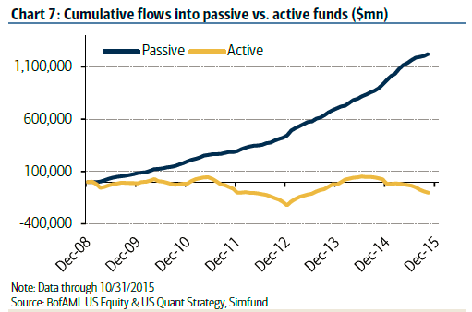
Passive Investing is Winning

Slide 6
Trading is Getting Cheaper

Slide 7
ESG for the Masses Or … ”Waiting for Uber”
Who will create the Uber of financial services?

Slide 8
Blake’s was Concerned He wanted something more…
Up
ing

